Slide 1

Welcome to
St. Mary’s P.S. Altinure
Usually, we would discuss this powerpoint at an Induction meeting with our Year 1 parents. This year, we ask you as parents to read through this information at home. We hope it helps inform you! If you have any issues or concerns, please contact Mrs Redmond via reception (02877781384) or by email. We look forward to meeting you and your children soon. Stay safe!

Slide 2

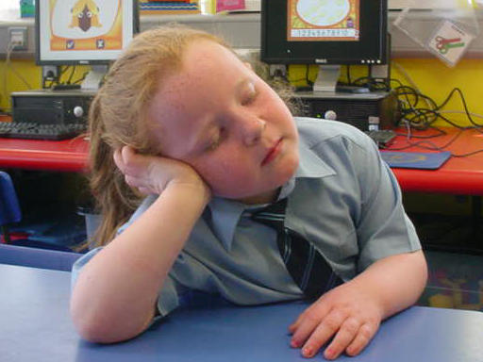
Our School Day
9: 20 – 9: 30 | Registration Admin Prayers
9: 30 – 10:30 | Play
10: 30-10:50 | Snack
10:50 –11:00 | Outside play
11:00- 12:20 | Curriculum
12:20- 12:40 | Dinner/Lunch
12:40- 1pm | Outside Play
1pm- 2pm | Curriculum
Usually staggered intake over 2 weeks. Children go home at 1pm during the month of September. Starting dates and days/times of attendance cannot be confirmed yet due to COVID 19.
An nitial parents’ meeting is usually held at end of October to let you know how your child is settling in.

Slide 3
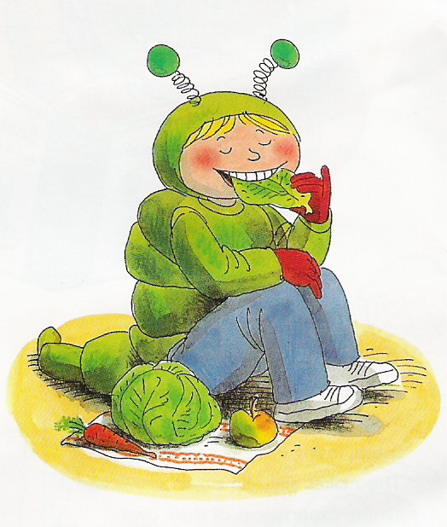
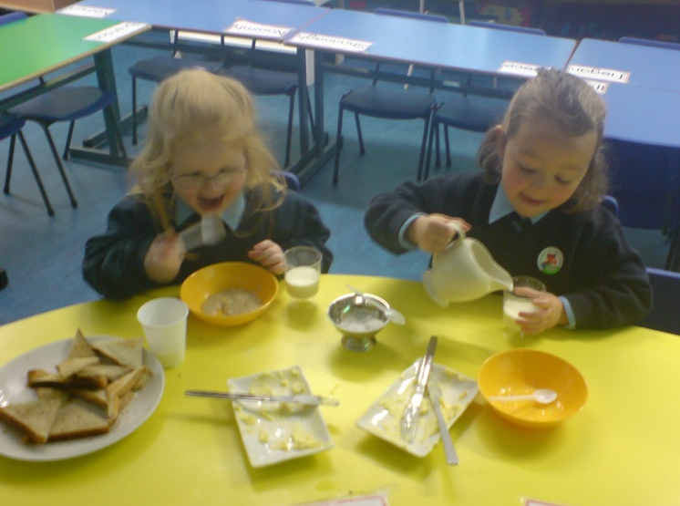
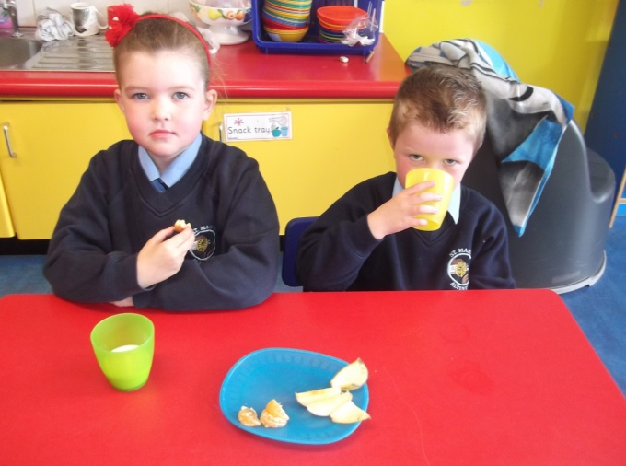
Healthy Eating School
Snack time incorporates several areas of the curriculum and is timetabled into the day.
Parents are asked to contribute £4 per month to cover the cost of this snack.
Selection of fruit
Vegetables from school garden
Choice of breads
Cheese
Ham
Yoghurt
Milk/Water
Lunch - one small treat allowed
Dinner costs £2.60 – menu available
Notes:
In the Foundation stage children are encouraged to develop independence, self-help skills and healthy lifestyle choices.
Our Snack time is built into the school timetable and is an important part of the school day as it promotes personal development skills and encourages social interaction.

Slide 4
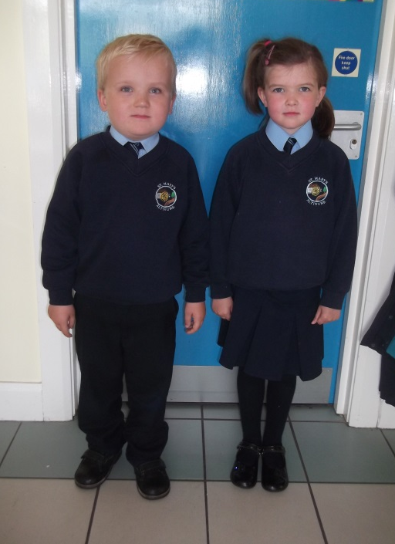
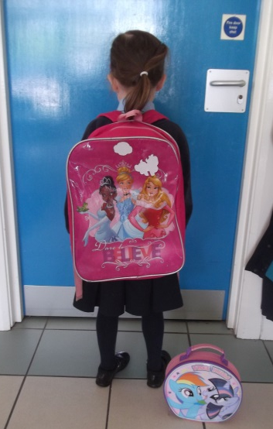
Uniform
Girls
Navy Skirt
Navy V-neck jumper/cardigan
Light-blue shirt
School tie
Boys
Navy Trousers
Navy, V-neck jumper
Light blue shirt
School tie
For P.E children will require black plimsolls.
Wellingtons will be required for outdoor play and forest school lessons.
Please ensure that all items of clothing etc. are clearly labelled.
Notes:
Uniforms are available from Select Schoolwear – Glendermot Rd, Waterside and Ferguson Fashions- Williams Street. A school coat is also available, but not statutory.
School ties and a school bag with the school crest are available for purchase at the school office. (School bag £4.00, tie £3.00)

Slide 5

School Bus
A 2 o’clock bus normally operates from October. There is a daily charge for this service.
Usual route is Straidarran, Craigbane, Slieveboy, Teenaght. You can put your name down for this service if you wish in September.
Collection Policy – we will
need to know who will collect your
child. You will complete a form when your child starts school.
Notes:
Who will be getting bus
Parents need to apply online

Slide 6

Additional Information
Please inform us as soon as possible if your child has allergies
We are a nut free school. Do
not send in lunchboxes. No
coconut or kiwi either.
We need permission from you for various policies eg Child Protection, Intimate care.. This will be sought when your child starts in September.
Please return completed data capture forms when you collect your child’s Induction Pack on Monday 22nd June.
Notes:
Administer medication forms for inhaler and epi-pen. Parents are made aware that if their child got their inhaler a form is filled out (time, date, dose given, any reactions)
It is the parents responsibility that medication is in date and also labelled.
Throughout the year let the school know of any changes to data capture form
Photographic consent

Slide 7
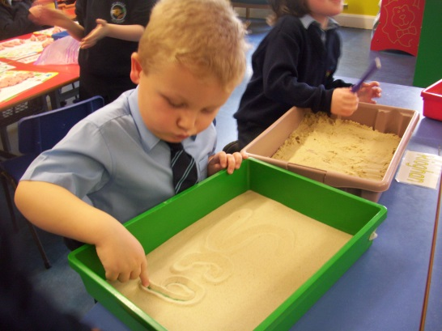
Foundation Stage Curriculum
Language and Literacy
Mathematics and Numeracy
The Arts
Personal Development & Mutual Understanding
Physical Development & Movement
The World Around Us
RE
RSE (Year 2)
Thinking Skills and Personal Capabilities
Using ICT
Notes:
The Foundation Stage Curriculum is built around six core learning areas plus RE (which is been agreed by the four main Christian Churches in NI and specified by the Department of Education).
The emphasis is on more flexible and integrated planning to best meet the needs and interests of the children.

Slide 8
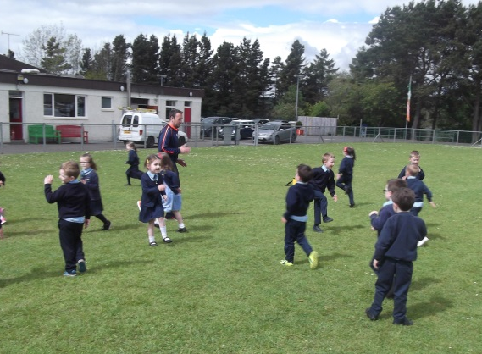
In/After School Activities
such as
Gymnastics
PE
Dance
After school activities are optional and take place after 2pm.

Slide 9
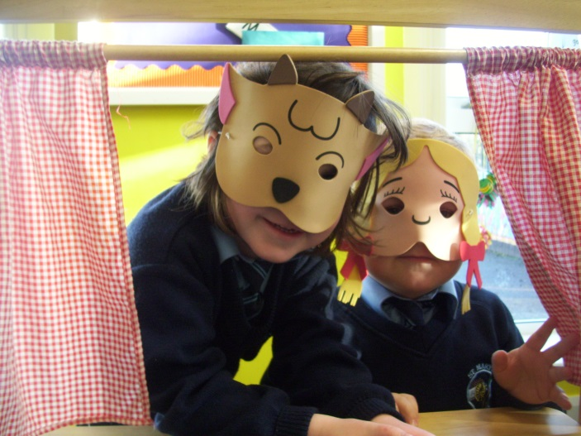
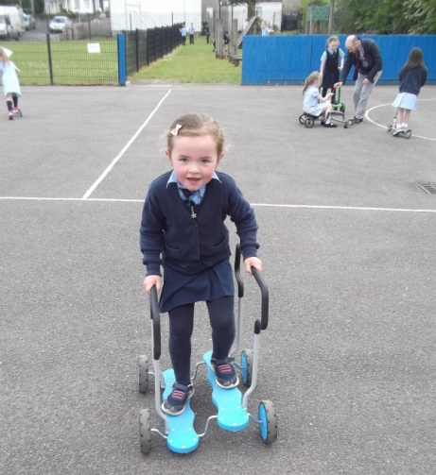
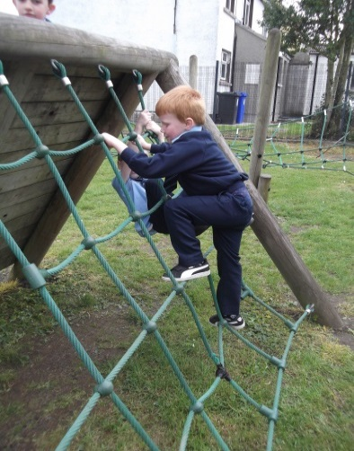
Learning through Play
Play is central to the Foundation curriculum.
It is a natural process which we all do in order to understand and learn.
Play activities keep the brain and body active.
It helps build confidence- you can’t fail when you are only playing.
Children have the opportunity to mix and get to know others.
It allows skills to be practised and rehearsed.
It is fun- gives a feeling of satisfaction.
Play also allows time for the teacher to
Talk / listen to your child
Observe your child’s progress.

Slide 10
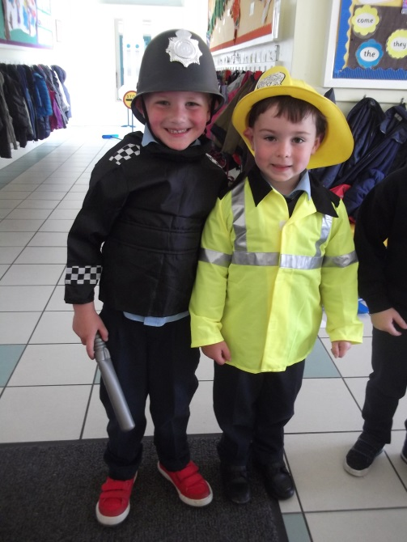
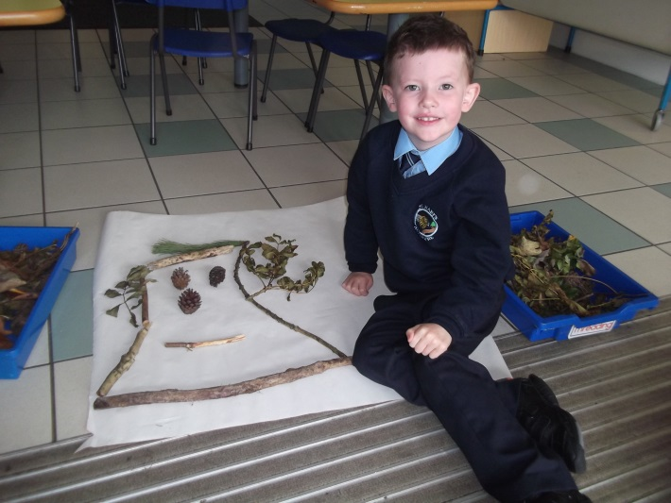
How can I help my child learn through play?
  Have fun – be an ‘eejit’!
Encourage all kinds of play.
Talk to your child.
Read and ‘rhyme’ with your child every day.
Remember daily routines are loaded with learning potential.
Reinforce turn-taking /sharing, etc.
Place emphasis on process NOT end product.
TAKE TIME OUT – enjoy spending time with your child !
Notes:
Share ideas for how parents can support children’s play at home – refer to final page of parents/carers’ leaflet for further ideas.

Slide 11
Listening and Attention
Talk about good listening
Good sitting
Good looking
Good thinking
Praise good listening
Encourage your child to listen to stories
Avoid too many distractions in the house e.g. turn off the T.V.
Play games which involve listening and taking turns

Slide 12

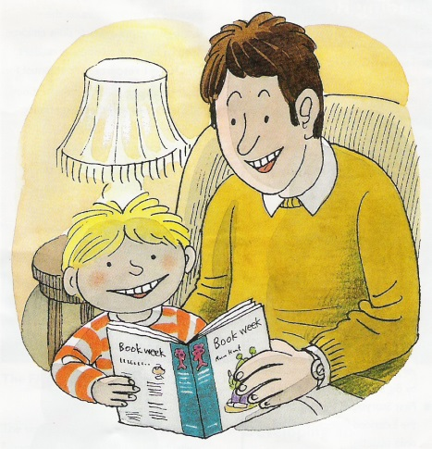
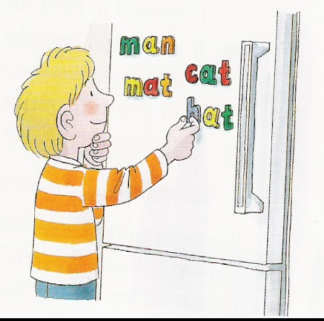
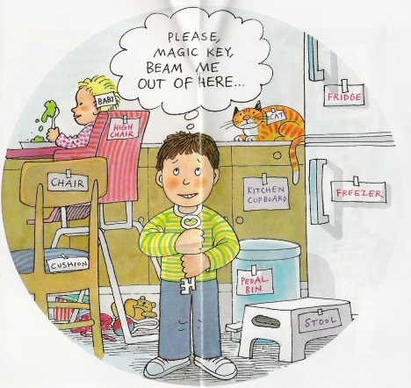
Reading at Home- Practical Tips
Talk about the title. Predict the story.
Relate your own experience.
Look through the pictures together.
Read the extended story to your child.
Point to all the words as you read. Model 1-1 matching.
Help your child to work out unknown words using initial letter sounds and picture cues.
Ask questions about the story.
Play games, use magnetic letters and word cards.
Notes:
Emphasise: Talk with children often – share family meals and special events and use them to model rich vocabulary and language use.
Enjoy playing with language – share rhymes, riddles, songs, jokes.
Use a variety of stories, factual books, activity books, nursery rhyme and poetry books:
Read with your child every day- anytime, anyplace, anywhere…make it fun!
Take time to look and talk about the pictures, title, author, etc.
Encourage your child to turn pages and to join in repeating phrases or words they recognise when they are at that stage.
Make sure you model reading for pleasure.
Read aloud shopping lists, messages, birthday cards, shop signs.
Provide a range of writing materials and encourage children to draw and write – model and involve them in authentic writing tasks.

Slide 13

Developing Handwriting
To develop fine motor skills:
Construction toys
Threading / lacing
Fastening buttons etc.
Play dough activities
Painting (at an easel)
Colouring
Cutting out

Slide 14
Letter Formation
c pattern letters
c, a d, g, o, q, s, e
l pattern letters
i, l, t, j, f, u, y
r pattern letters
r, n, m, h, b, p
zigzag pattern
v, w, z, x, k.

Slide 15
Transition
This year, we have been unable to bring in our new Year One pupils to help them get used to our school setting.
Please watch the video message (on our website) with your child to familiarise him/her with their teacher, Miss Kealey, and life at school. Re-watch it at different times over the summer. This should help them settle in better in September.
Come to school on Monday 22nd June with your child and he/she can see the Year One classroom and collect the Induction Pack. Then you can have conversations with your child about school over the summer to help him/her prepare.
Please know that your child’s emotional well-being will be our greatest priority in September. It will all be fine!

Slide 16

At St. Mary’s P.S. your child’s happiness is our priority.
‘Don’t educate your children to be rich. Educate them to be happy, so they know the value of things, not the price’.
Thank you.

